Slide 1

Introduction to History of Uzbekistan Foundations: Geography, Statehood, & Civilizational Migration

Slide 2

Why we learn history as a mandatory subject?

Slide 3
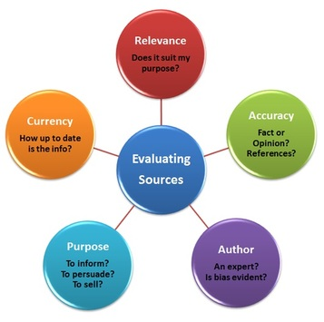
Higher education institutions aim to develop critical thinking, institutional literacy, and civic awareness—skills essential for any career.
Critical Thinking and Source Analysis: History forces students to evaluate conflicting accounts, identify bias, distinguish primary from secondary sources, and build evidence-based arguments rather than accepting claims at face value.

Slide 4
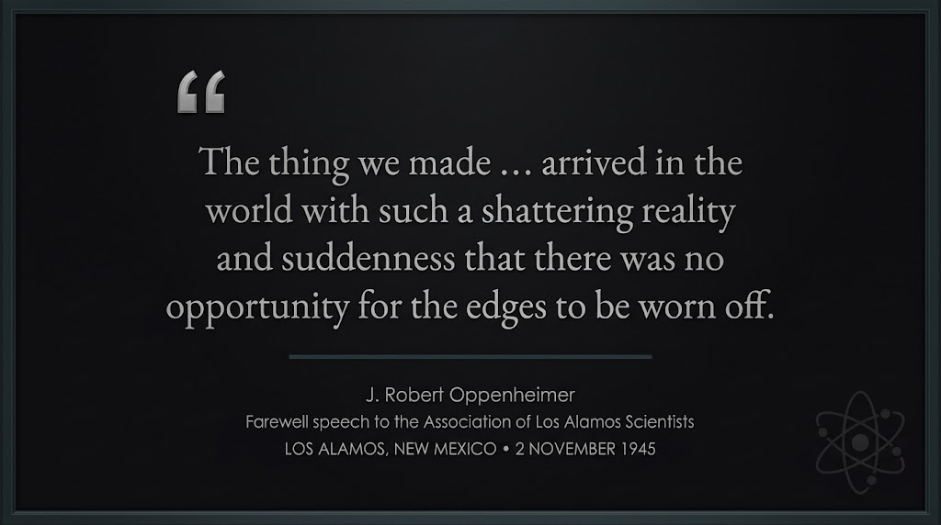
Contextualizing Modern Systems: Fields like law, medicine, technology, engineering, and economics do not exist in a vacuum. Understanding how current political structures, ethical codes, global trade networks, and social systems evolved prevents professional blind spots.

Slide 5
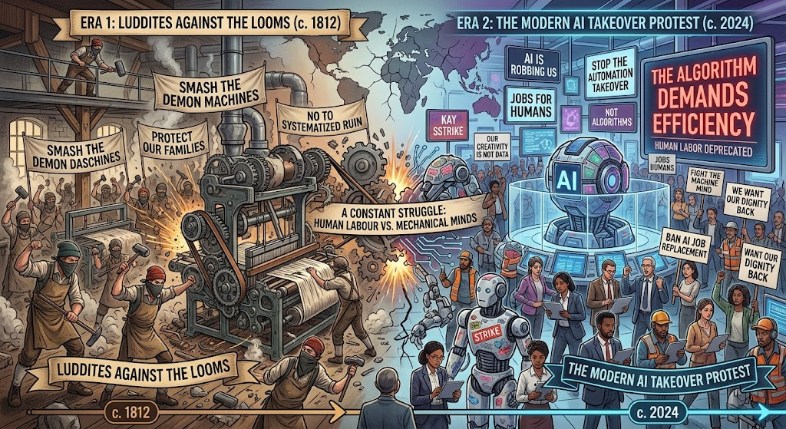
Complex Problem Solving: Historical study teaches pattern recognition across time, demonstrating how actions produce unintended secondary and tertiary consequences over decades.

Slide 6

The Prohibition of Alcohol in the US (1920):
Initial Action: The 18th Amendment banned the sale of alcohol to promote public morality and health.
Secondary Effect: Legal saloons closed, but illegal underground bars (speakeasies) surged, creating a massive, untaxed black market.
Tertiary Effect: Violent organized crime syndicates (like Al Capone's mafia) grew into powerful multi-million-dollar enterprises, leading to widespread law enforcement corruption and the eventual repeal of the law in 1933.

Slide 7

Civic Responsibility and Literacy: Universities are tasked with producing informed citizens capable of participating in governance, understanding policy decisions, and recognizing historical precedents for current political debates.

Slide 8

Communication and Synthesis: Writing-intensive history courses train students to synthesize massive amounts of complex, ambiguous data into concise, coherent written arguments—a primary skill valued by employers across all industries.

Slide 9
HISTORICAL PERIODIZATION

Slide 10
Historical periodization is the practice of dividing history into distinct, named blocks of time to make the study, analysis, and teaching of history easier. Instead of looking at history as one long, continuous flow, historians group events into periods based on common features, such as:
Political systems (e.g., Ancient, Medieval, Modern periods)
Economic structures (e.g., Agricultural, Industrial, Digital ages)
Cultural or intellectual movements (e.g., Renaissance, Enlightenment)
Major turning points (e.g., pre-Islamic vs. Islamic period in Central Asia)

Slide 11
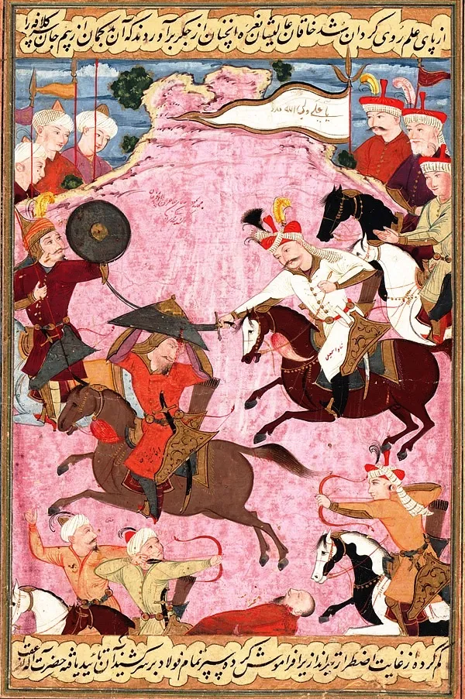
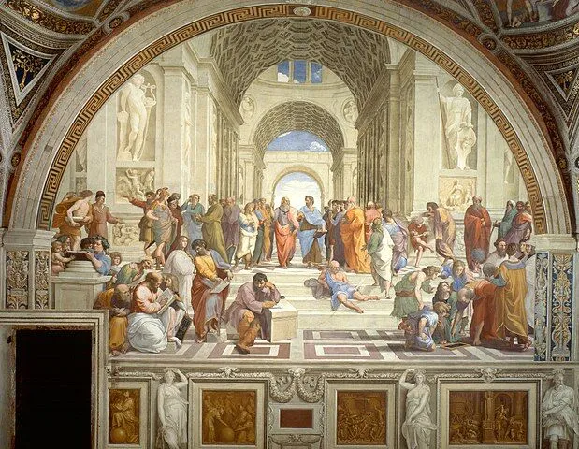
HISTORICAL PERIODIZATION ALSO DEPENDS GEOGRAPHICAL LOCATION

Slide 12
Prehistoric time
Ancient time
from the invention of writing around 3000 B.C to the fall of the Western Roman Empire around 476 C.E
the extensive span of human history before the invention of writing systems

Slide 13
MODERN PERIOD
MEDIEVAL PERIOD
EARLY MODERN PERIOD
CONTEMPORARY ERA
The medieval era, often called The Middle Ages or the Dark Ages, began around 476 A.D. following a great loss of power throughout Europe by the Roman Emperor. The Middle Ages span roughly 1,000 years, ending between 1400 and 1450
refers to the period after the Middle Ages and up to the 19th century
subset of modern history that describes the historical period from about 1945 to the present.

Slide 14
Most important inventions of human history?

Slide 15
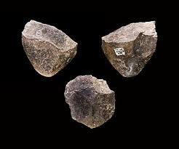
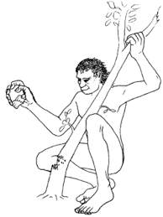
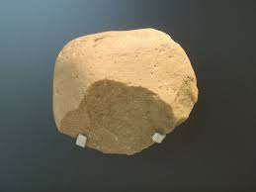
CHOPPER -A PEBBLE TOOL WITH AN IRREGULAR CUTTING EDGE FORMED THROUGH THE REMOVAL OF FLAKES FROM ONE SIDE OF A STONE.

Slide 16
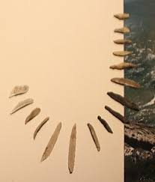
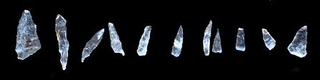
A MICROLITH IS A SMALL STONE TOOL USUALLY MADE OF FLINT OR CHERT AND TYPICALLY A CENTIMETRE OR SO IN LENGTH AND HALF A CENTIMETRE WIDE. THEY WERE MADE BY HUMANS FROM AROUND 60,000 YEARS AGO, ACROSS EUROPE, AFRICA, ASIA AND AUSTRALIA. THE MICROLITHS WERE USED IN SPEAR POINTS AND ARROWHEADS.

Slide 17
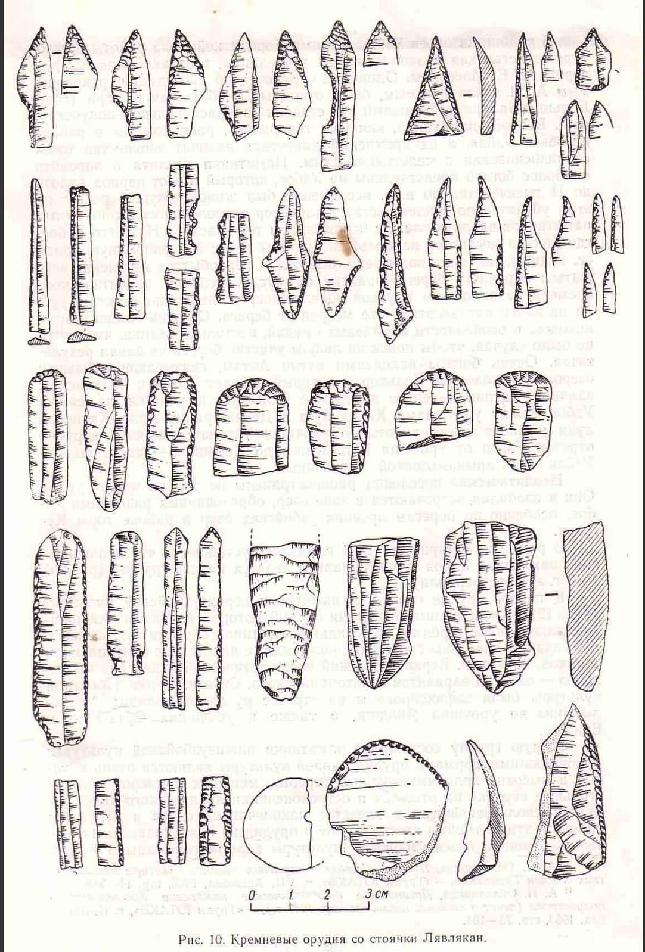

Slide 18
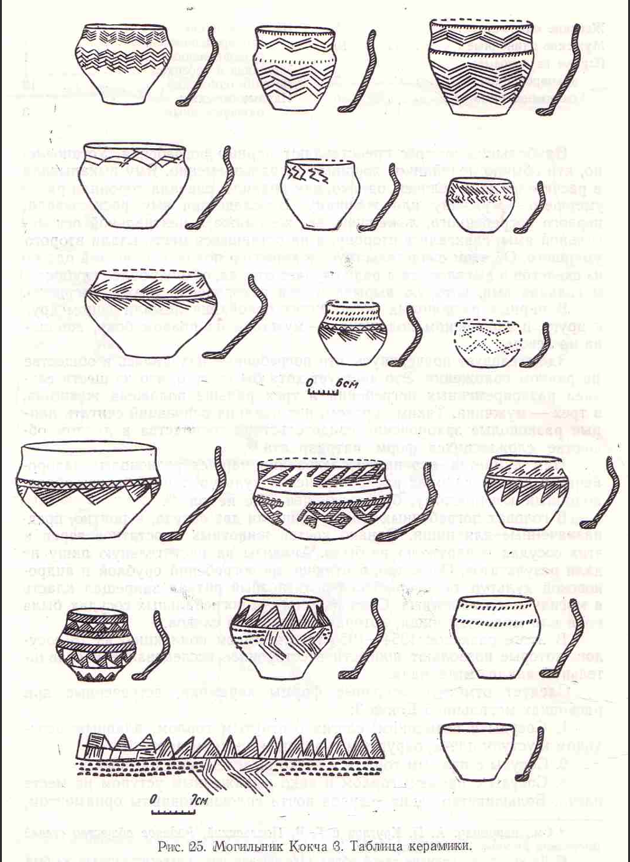
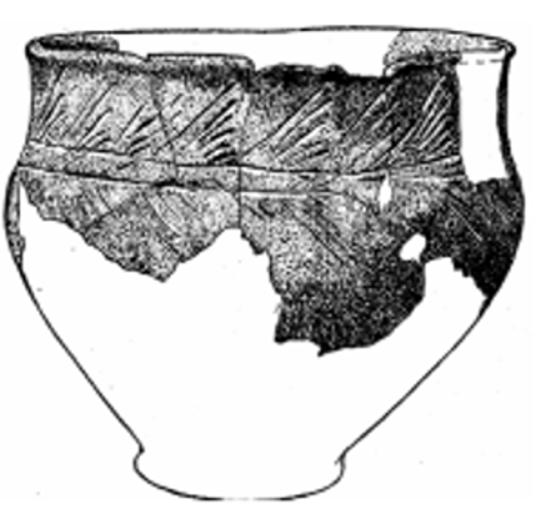
ANCIENT POTTERY -POTTERY IS ONE OF THE OLDEST HUMAN INVENTIONS, ORIGINATING BEFORE THE NEOLITHIC PERIOD

Slide 19
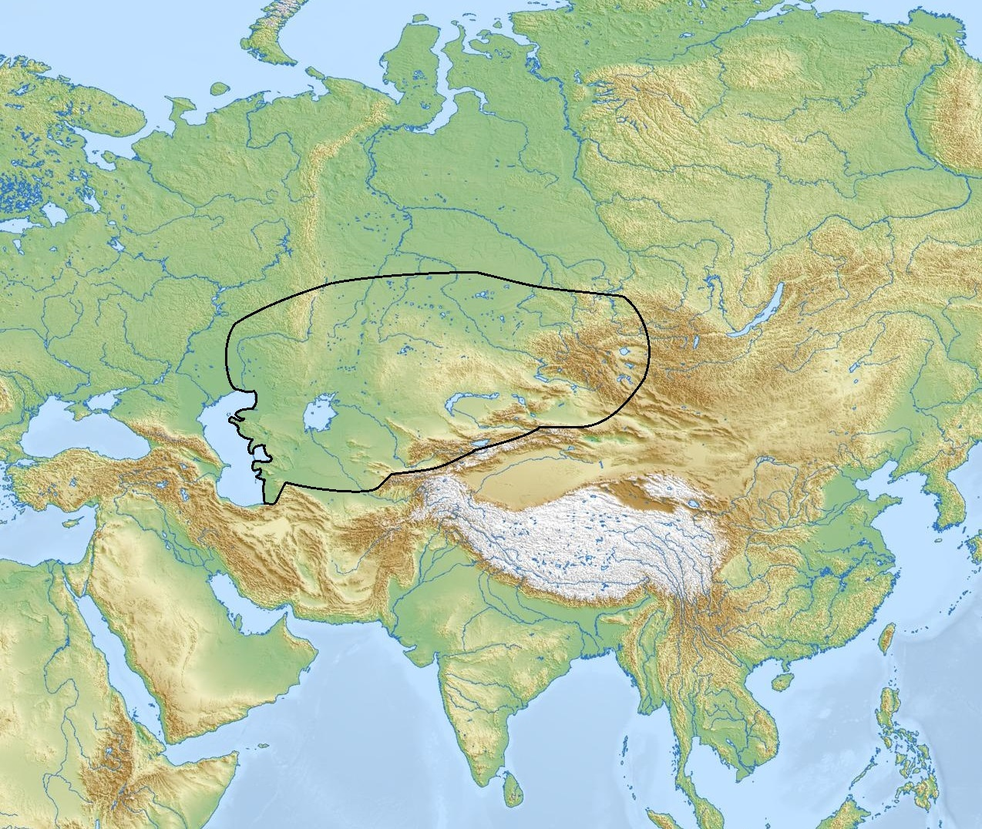
ANDRONOVO CULTURE
BELONGS TO INDO-IRANIAN NOMADS OF CENTRAL ASIAN STEPPE
LANGUAGE GROUP IS INDO IRANIAN BUT SAID TO BE OF TURKIC ORIGINS( NOT PROVEN)
MANY SCHOLARS ARGUE WHETHER TOZABOGYOP AND SUVYORGAN CULTURES ARE PART OF ANDRONOVO OR NOT

Slide 20
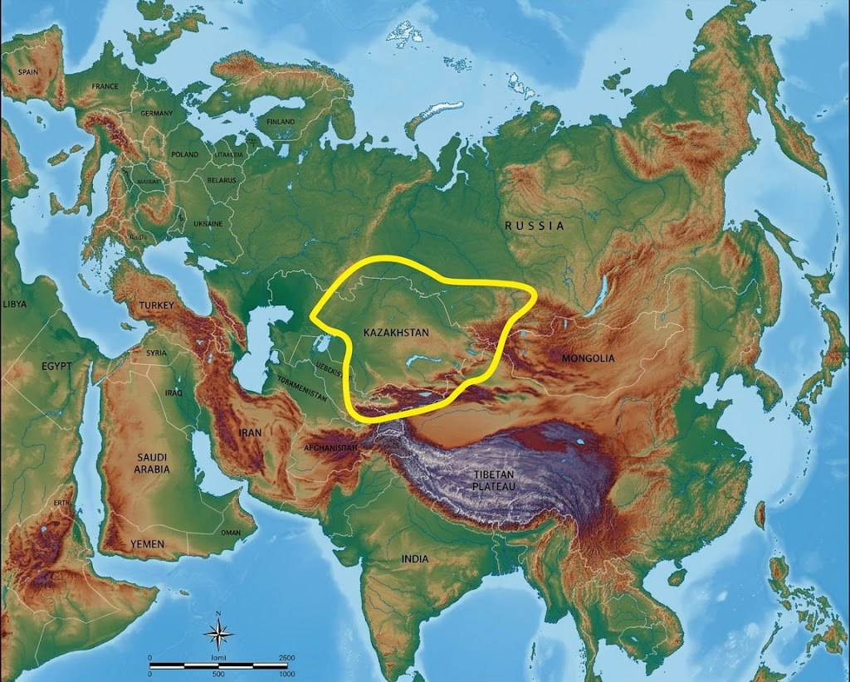

Slide 21
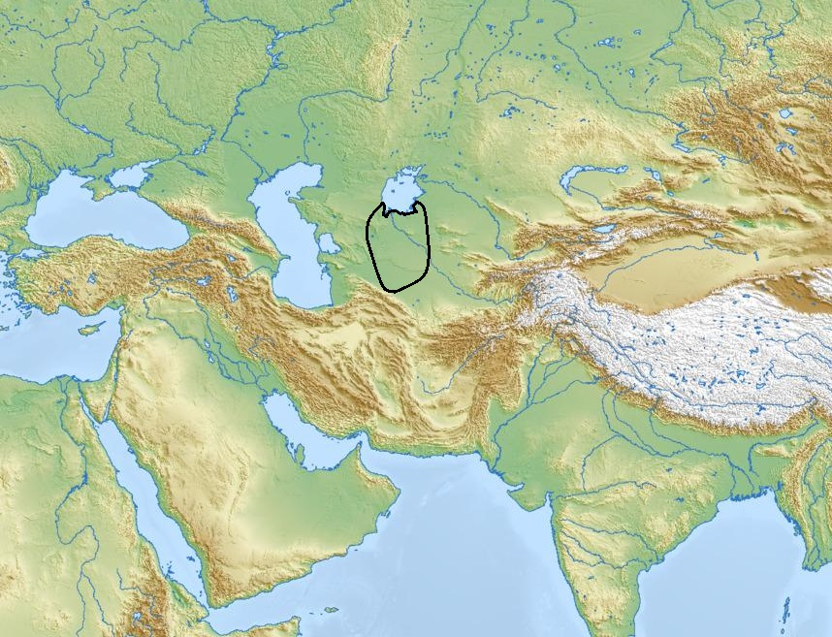

Slide 22
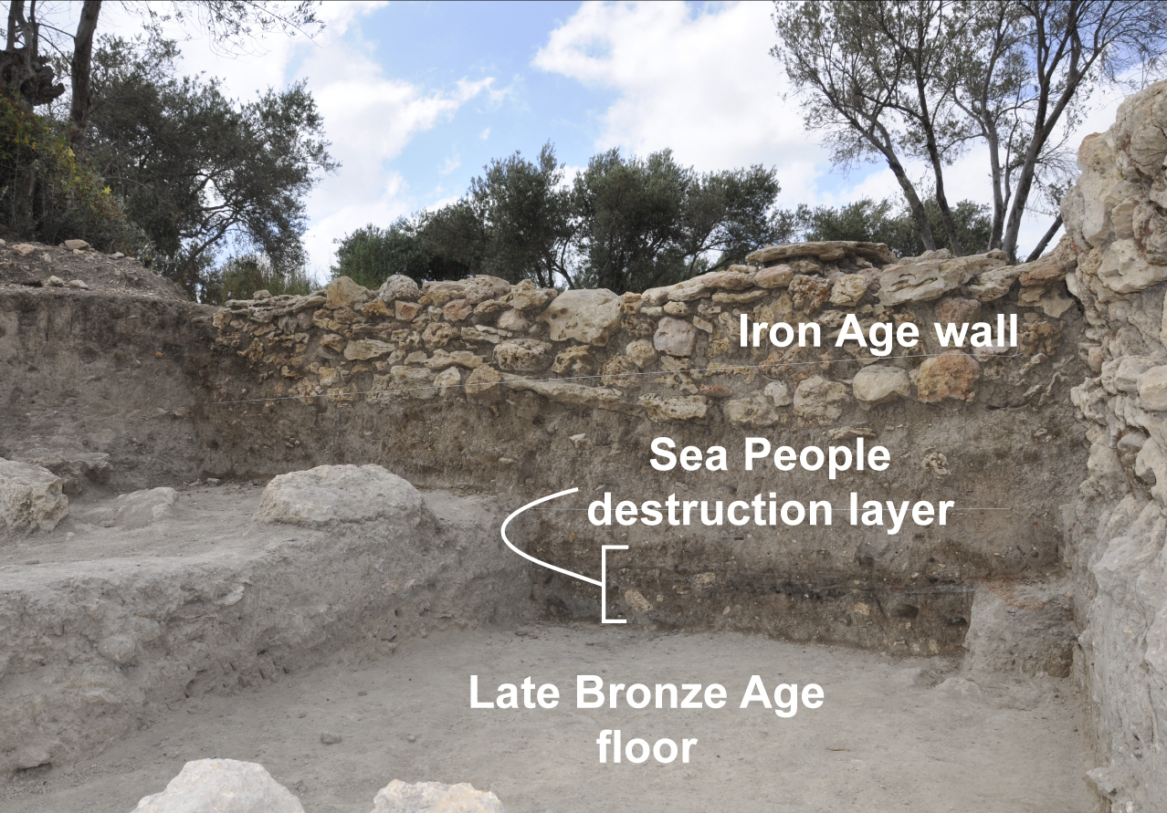
An archaeological culture is a specific group of recurring artifacts, structures, and monuments found in a particular region and period that represent the material remains of a past human society
A cultural layer is a distinct deposit of soil, artifacts, and organic remains left behind by human activity at an archaeological site over a specific period

Slide 23
Architecture and housing and importance of water resource in Central Asia

Slide 24
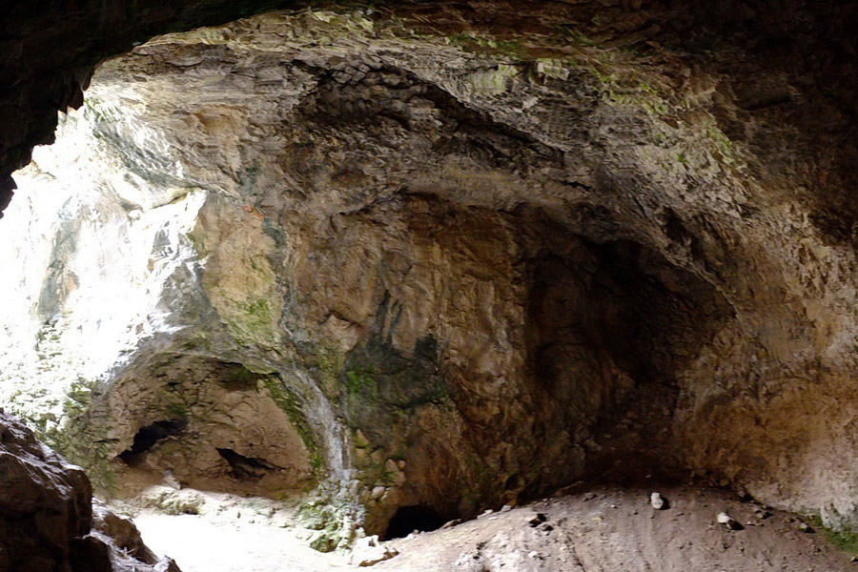
Human housing evolved alongside changes in mobility, agriculture, technology, and materials.
OBI RAKHMAT GROTTO

Slide 25
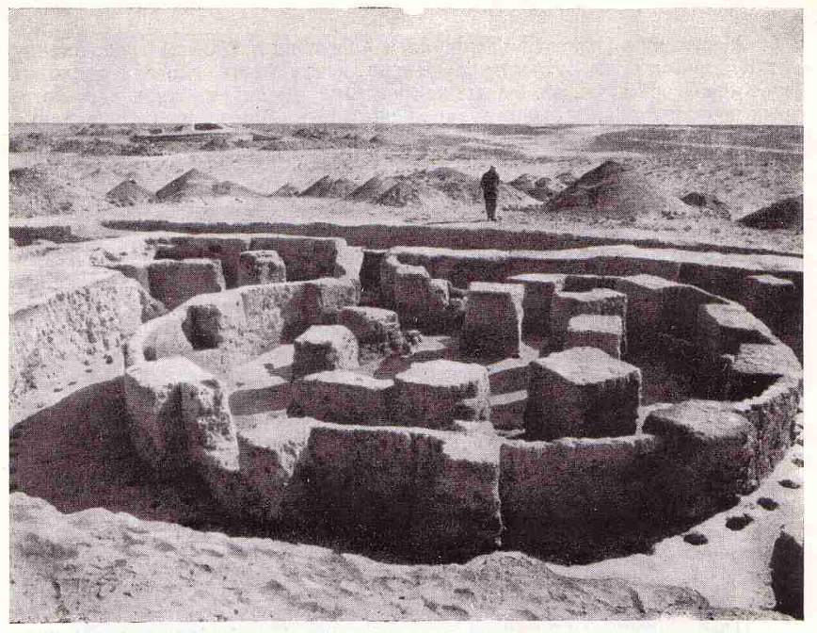
A pit-house is a house built in the ground and used for shelter.
Pit-houses were built by digging the ground to some depth and covering the area with straw and hey

Slide 26
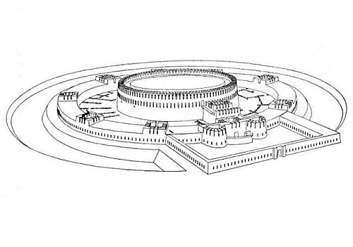
Koi Krylgan Kala (Uzbek: Qoʻyqirilgan qalʼa) is an archaeological site located outside the village of Taza-Keltiminar culture in the Ellikqala District in the Republic of Karakalpakstan, an autonomous republic of Uzbekistan. In ancient times, it was sited along a canal in the Oxus delta region. Dates to IV-III B.C. one of the examples of urbanization in Central Asia known to have an observatory

Slide 27
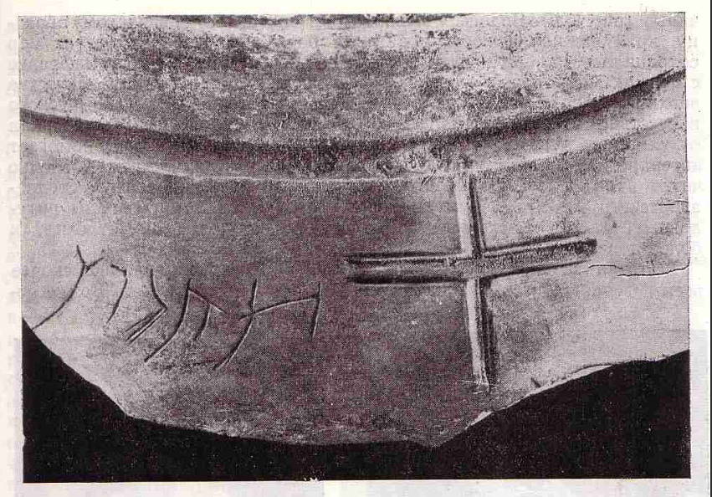
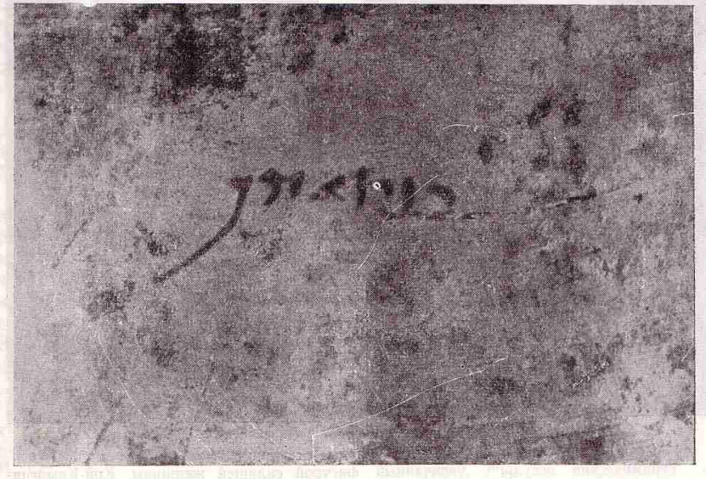
Koi krylgan kala is also known to contain the very first writing system of Central Asia Khwarezmian script

Slide 28
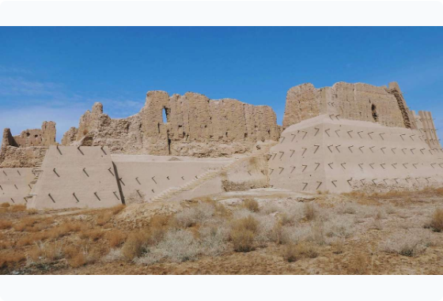

Toprak-Kala: Ancient Royal Capital
◆
Royal Seat of Power (1st–4th C. CE): Toprak-Kala served as the administrative and ceremonial palace complex of the Khwarezmshah rulers.
◆
Mudbrick Engineering: Built entirely of high-durability mudbrick (paksha) blocks set on massive elevated platforms to resist soil dampness and sandstorms.
◆
Archive & Culture: Excavated by S.P. Tolstov in 1938; uncovered official administrative records in ancient Khwarezmian script (Aramaic-derived).
◆
Religious Triad: Featured dedicated temple chambers honoring Ahura Mazda, Anahita, and Mithra.

Slide 29
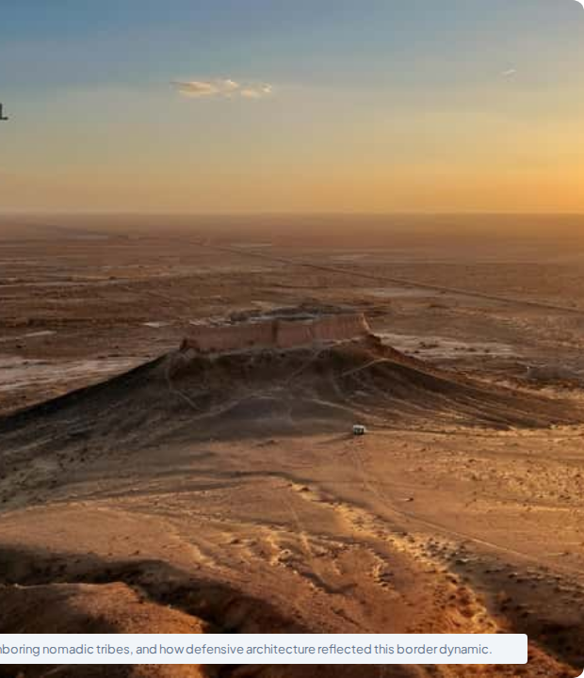
Ayaz-Kala: Frontier Citadel
The Golden Ring of Fortresses: Ayaz-Kala was part of a string of border fortresses erected along the edge of the Kyzylkum Desert.
Strategic Defense: Positioned on a 100m natural limestone cliff, providing panoramic surveillance to defend settled oases against Saka and nomadic steppe raids.
Multi-Stage Citadel Complex: Comprises Ayaz-Kala 1 (4th C. BCE lookout post), Ayaz-Kala 2 (feudal Afrighids), and Ayaz-Kala 3 (huge garrison enclosure).

Slide 30
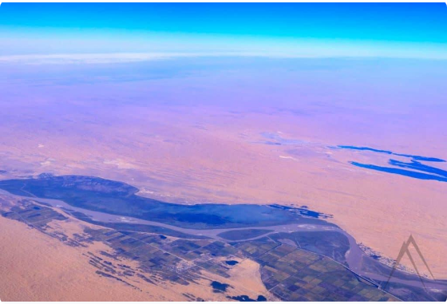
Central Asian statehood emerged along major meltwater rivers (Amu Darya / Oxus and Syr Darya / Jaxartes) surrounded by the Kyzylkum and Karakum deserts.
◆
◆
Ecosystem Pressures: Settlement patterns were forced to stay mobile or develop high-level hydro-engineering to track shifting water courses.
https://www.google.com/maps?authuser=0

Slide 31
Problems and solutions of Central Asian water crisis

